Slide 1
MATH CO-PROCESSOR 8087

Slide 2
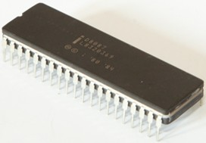
INTRODUCTION
8087 was the first math coprocessor for 16-bit processors designed by Intel.
It was built to pair with 8086 and 8088.
The purpose of 8087 was to speed up the computations involving floating point calculations.
Addition, subtraction, multiplication and division of simple numbers is not the coprocessor’s job.
It does all the calculations involving floating point numbers like scientific calculations and algebraic functions.

Slide 3
INTRODUCTION
20-Nov-10
By having a coprocessor, which performs all the calculations, it can free up a lot of CPU’s time.
This would allow the CPU to focus all of its resources on the other functions it has to perform.
This increases the overall speed and performance of the entire system.
This coprocessor introduced about 60 new instructions available to the programmer.
All the mnemonics begin with “F” to differentiate them from the standard 8086 instructions.
For e.g.: in contrast to ADD/MUL, 8087 provide FADD/FMUL.
www.eazynotes.com

Slide 4
INTRODUCTION
Math coprocessor is also called as:
  Numeric Processor Extension (NPX)
  Numeric Data Processor (NDP)
  Floating Point Unit (FPU)

Slide 5
ARCHITECTURE OF 8087
20-Nov-10
8087 coprocessor is designed to operate with 8086 microprocessor.
The microprocessor and coprocessor can execute their respective instructions simultaneously.
Microprocessor interprets and executes the normal instruction set and the coprocessor interprets and executes only the coprocessor instructions.
All the coprocessor instructions are ESC instructions, i.e. they start with “F”.
www.eazynotes.com

Slide 6
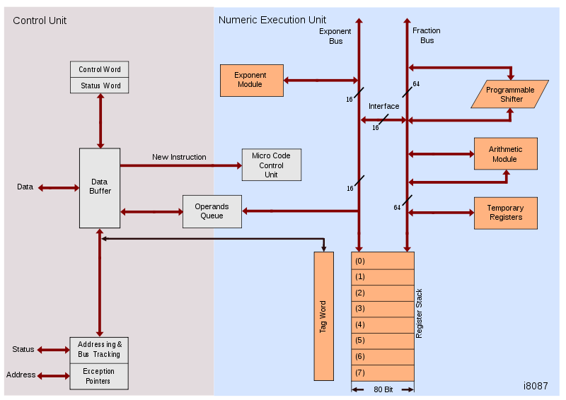
ARCHITECTURE OF 8087

Slide 7
ARCHITECTURE OF 8087
The internal structure of 8087 coprocessor is divided into two major sections:
  Control Unit (CU)
  Numerical Execution Unit (NEU)

Slide 8
CONTROL UNIT (CU)
It interfaces coprocessor to the microprocessor system bus.
It also synchronize the operation of the coprocessor and the microprocessor.
This unit has a Control Word, Status Word and Data Buffer.
If an instruction is ESC instruction, then coprocessor executes it.
If not, then microprocessor executes.

Slide 9
NUMERIC EXECUTION UNIT (NEU)
20-Nov-10
This unit is responsible for executing all coprocessor instructions.
It has an 8 register stack that holds the operands for instructions and result of instructions.
The stack contains 8 registers that are 80-bits wide.
Numeric data is transferred inside the coprocessor in two parts:
  64-bit mantissa bus
  16-bit exponent bus
www.eazynotes.com

Slide 10
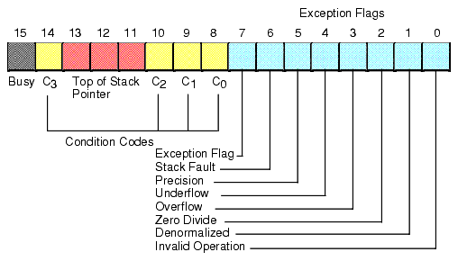
STATUS REGISTER

Slide 11
STATUS REGISTER
Status Register tells the overall status of 8087 coprocessor.
It is a 16-bit register.
It is accessed by executing the FSTSW instruction.
This instruction stores the contents of status register into memory.
Once the status is stored in memory, the bit positions of the status register can be examined.

Slide 12
STATUS REGISTER
Busy: It indicates that the coprocessor is busy executing the task.
Condition Codes (C₀-C₃): They indicate various conditions about the coprocessor.
Top of Stack: It indicates a register as top of stack register, out of the eight stack registers.
Exception Flag: It is set if any of the exception flag bits (SF, PR, UF, OF, ZD, DN, IO) are set.

Slide 13
STATUS REGISTER
Stack Fault: It is not available in 8087. It is active only in 80387 and above.
Precision: It indicates that the result has exceeded the selected precision.
Underflow: It tells if the result is too small to fit in a register.
Overflow: It tells if the result is too large to fit in a register.

Slide 14
STATUS REGISTER
20-Nov-10
Zero Divide: It indicates that you try to divide a non-zero value by zero.
Denormalized: It indicates that at least one of the operand is de-normalized.
Invalid Operation: It indicates an invalid operation. For e.g.: pushing more than eight items onto the stack, attempting to pop an item off an empty stack or taking the square root of a negative number.
www.eazynotes.com

Slide 15
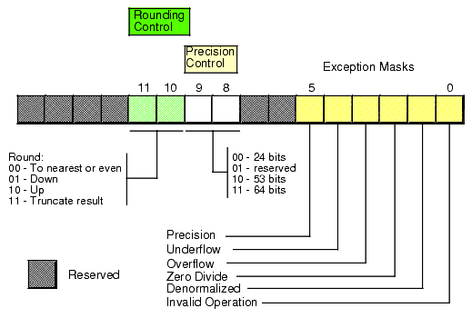
CONTROL REGISTER

Slide 16
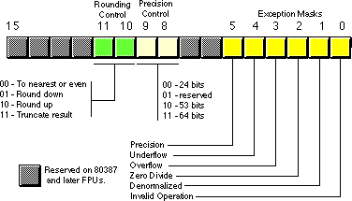
CONTROL REGISTER
20-Nov-10
Control Register controls the operating modes of 8087.
It is also a 16-bit register.
It performs rounding control and precision control.
It is also used to do masking and unmasking of the exception bits that correspond to the rightmost six bits of the status register.
FLDCW instruction is used to load the value into control register.
www.eazynotes.com

Slide 17
CONTROL REGISTER
Rounding Control: It determines the type of rounding or truncating to be done.
Precision Control: It sets the precision of the result.
Exception Masks: It determines that whether an error effects the exception bits in the status register.
  If it is one, then the corresponding error is ignored.
  If it is zero and the corresponding error occurs, then it generates an interrupt, and the corresponding bit in status register is set.

Slide 18
TAG REGISTER
TAG 7
TAG 6
TAG 5
TAG 4
TAG 3
TAG 2
TAG 1
TAG 0
Tag Values:
00 = Valid
01 = Zero
10 = Invalid
11 = Empty

Slide 19
TAG REGISTER
TAG 7
TAG 6
TAG 5
TAG 4
TAG 3
TAG 2
TAG 1
TAG 0
Tag Values:
00 = Valid
01 = Zero
10 = Invalid
11 = Empty
Tag Register is used to indicate the contents of each register in the stack.
There are total 8 tags (Tag 0 to Tag 7) in this register and each tag uses 2 bits to represent a value.
Therefore, it is a 16-bit register.

Slide 20
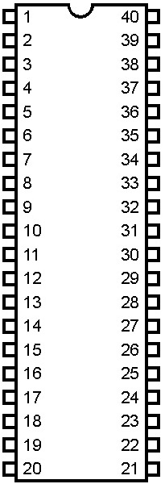
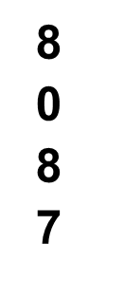
PIN DIAGRAM OF 8087
20-Nov-10
GND
V_{CC}
AD₁₄
AD₁₅
AD₁₃
A₁₆/S₃
AD₁₂
A₁₇/S₄
AD₁₁
A₁₈/S₅
AD₁₀
A₁₉/S₆
AD₉
BHE/S₇
AD₈
RQ/GT₁
AD₇
INT
AD₆
RQ/GT₀
www.eazynotes.com
AD₅
NC
AD₄
NC
AD₃
S₂
AD₂
S₁
AD₁
S₀
AD₀
QS₀
NC
QS₁
NC
BUSY
CLK
READY
GND
RESET

Slide 21
INTERFACING OF 8086 AND 8087
Multiplexed address-data bus lines are connected directly from 8086 to 8087.
The status lines and the queue status lines are connected directly from 8086 to 8087.
The Request/Grant (RQ/GT₀ and RQ/GT₁) signals of 8087 are connected to RQ/GT₀ and RQ/GT₁ of 8086.
BUSY signal of 8087 is connected to TEST pin of 8086.

Slide 22


